Slide 1
3D Printer committee
Drake Memorial Library
The College at Brockport
March 6th, 2015

Slide 2
Overview
“Maker Faire is the Greatest Show (and Tell) on Earth—a family-friendly showcase of invention, creativity and resourcefulness, and a celebration of the Maker movement. It’s a place where people show what they are making, and share what they are learning.”
“Makers range from tech enthusiasts to crafters to homesteaders to scientists to garage tinkerers. They are of all ages and backgrounds. The aim of Maker Faire is to entertain, inform, connect and grow this community.”
94 Maker Booths
6 Maker Talks/Presentations

Slide 3
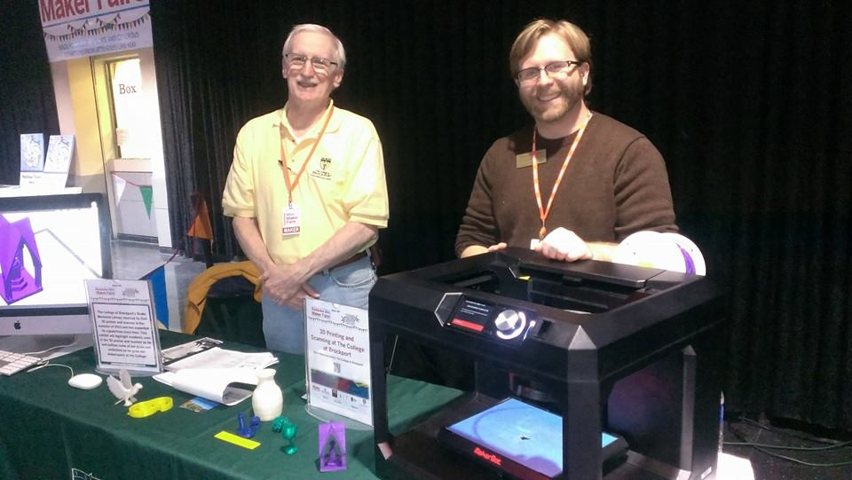
Our Presentation

Slide 4
Our Presentation
Explained the principles of 3D design and printing
Outlined ideas for an anticipated Makerspace to be constructed in the Drake Memorial Library
Spoke about applications for 3D printing and scanning at a 4-year comprehensive college
Spoke about collaborations and projects up to that point
Worked with art faculty and students to scan and print nature objects
Offered free printing to students during the Fall 2013 semester and thereafter for a small materials fee

Slide 5
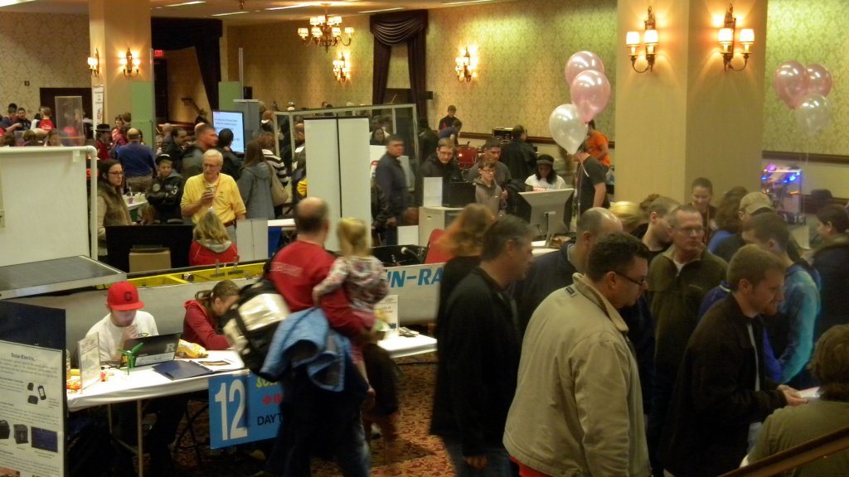
Other Makers

Slide 6
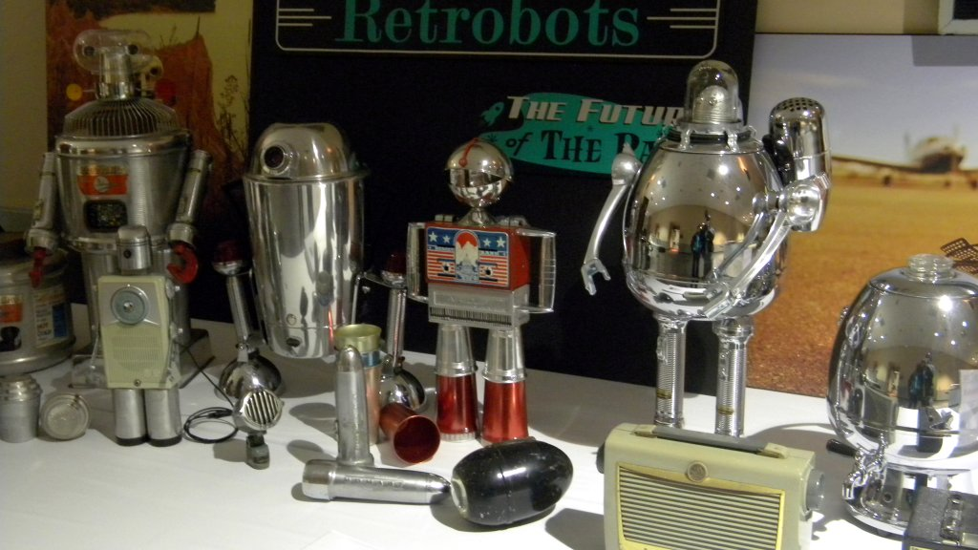

Slide 7
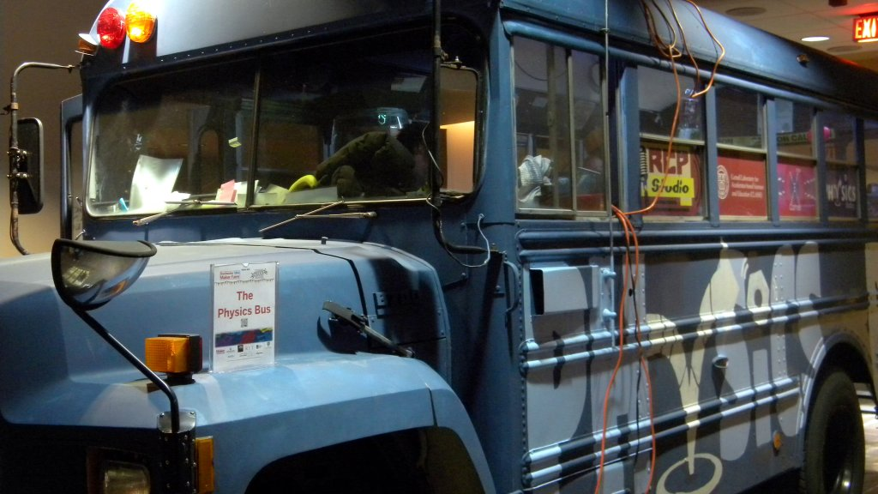
The Physics Bus
http://on.rocne.ws/1s4bMKD

Slide 8
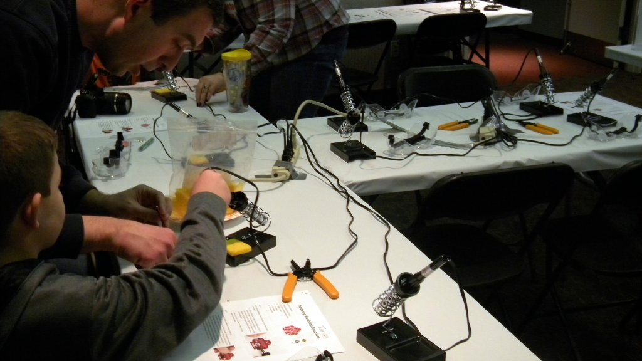
Soldering station for Maker Faire LED pins

Slide 9
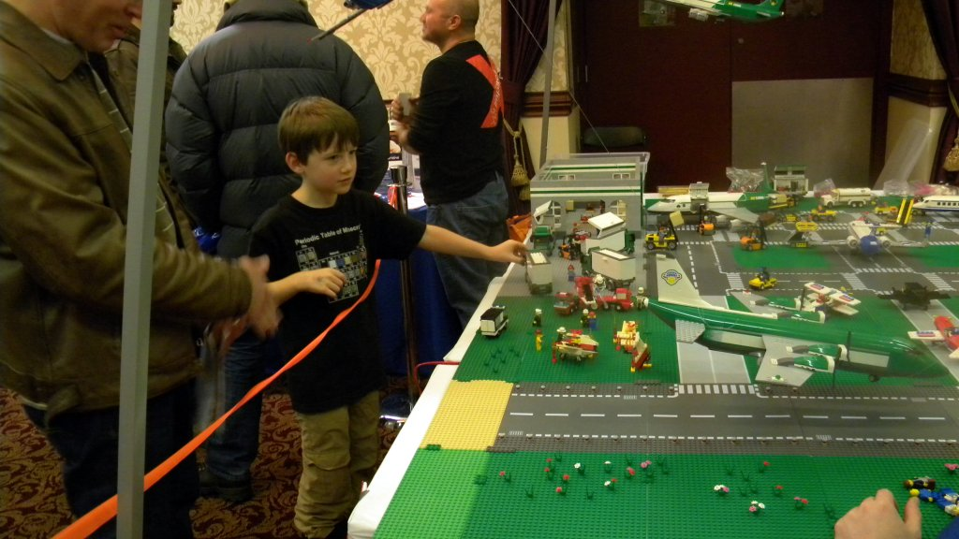
Rochester Lego User Group http://www.rochlug.org/

Slide 10
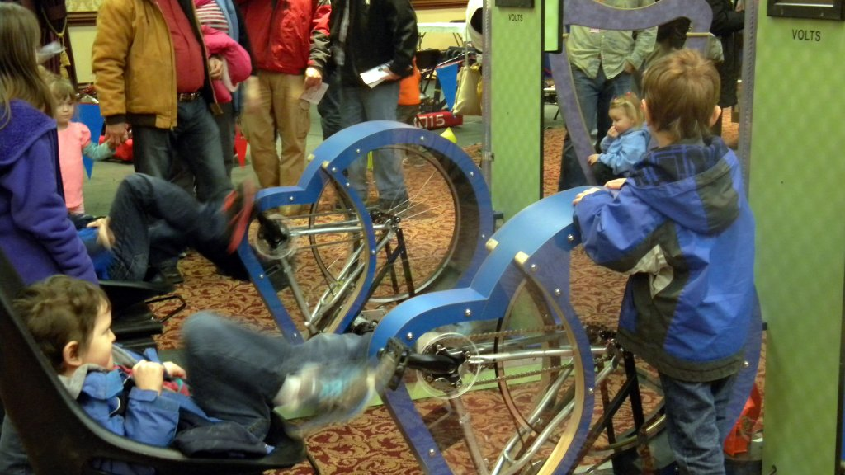

Slide 11
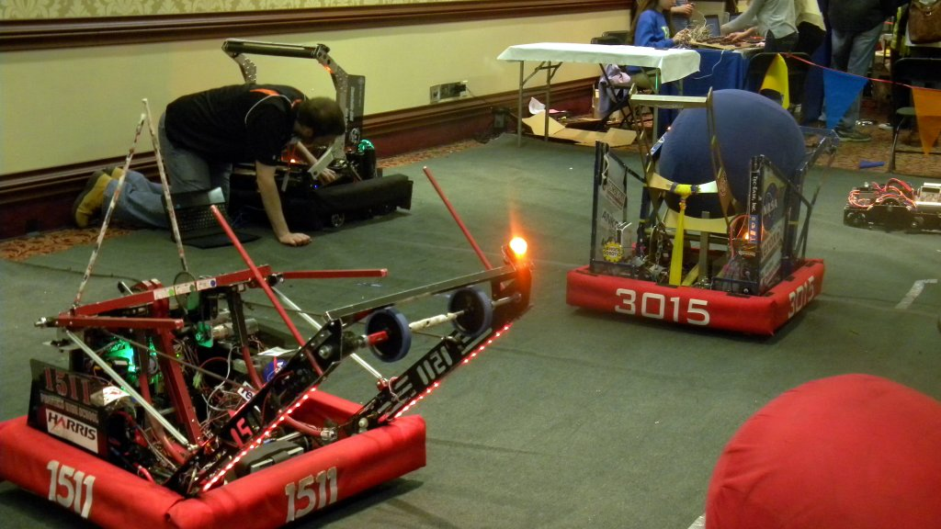

Slide 12
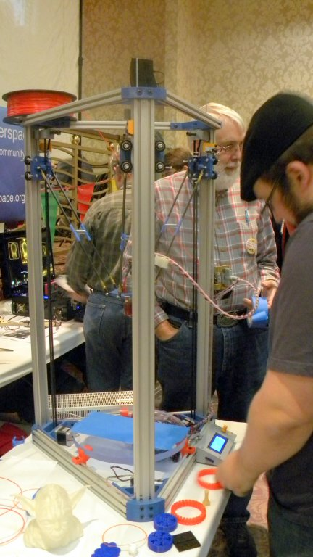

Slide 13
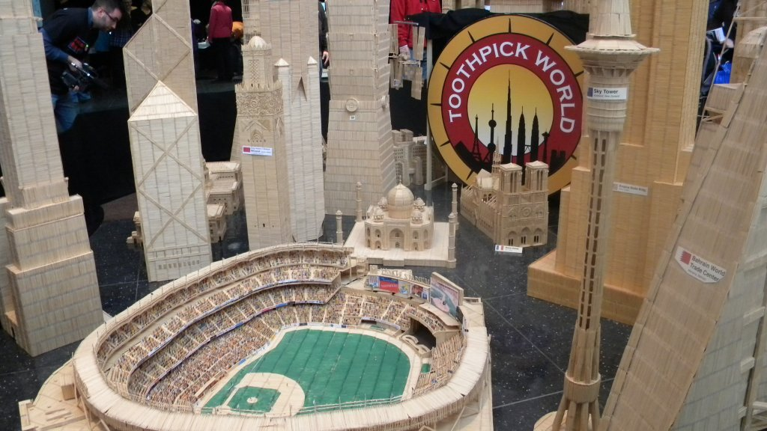
Toothpick World http://www.toothpickworld.com

Slide 14
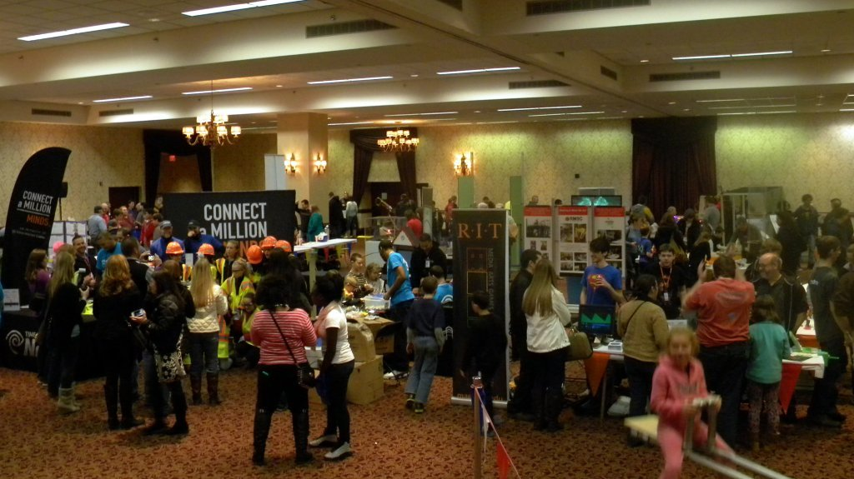

Slide 15
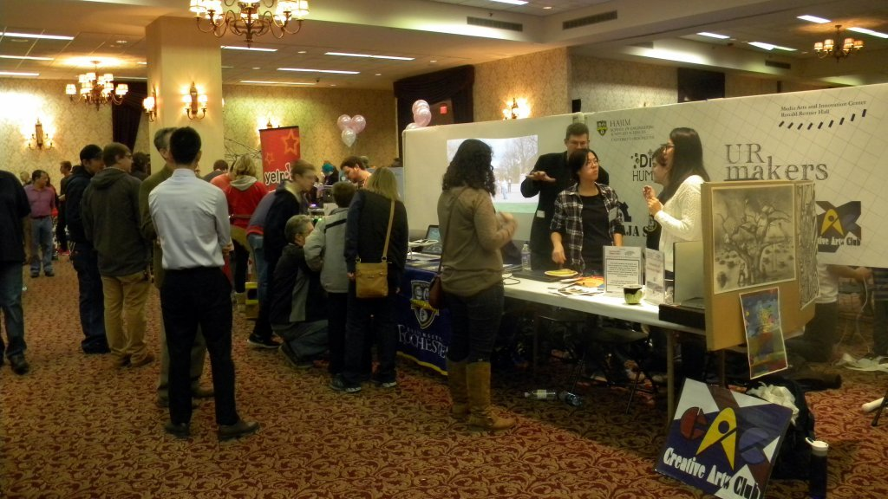

Slide 16
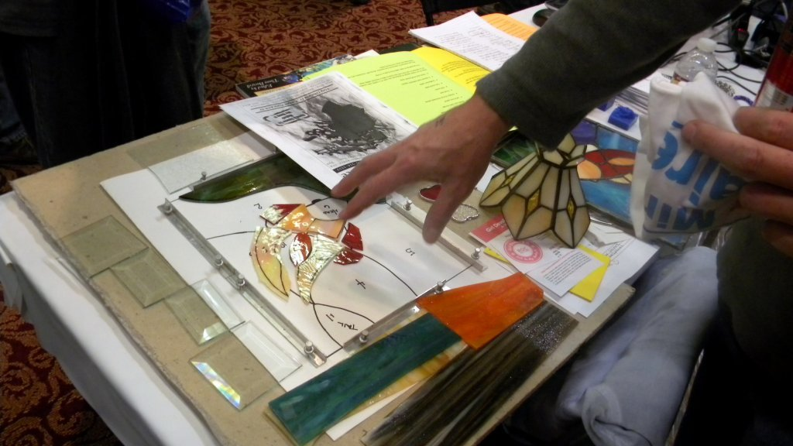

Slide 17
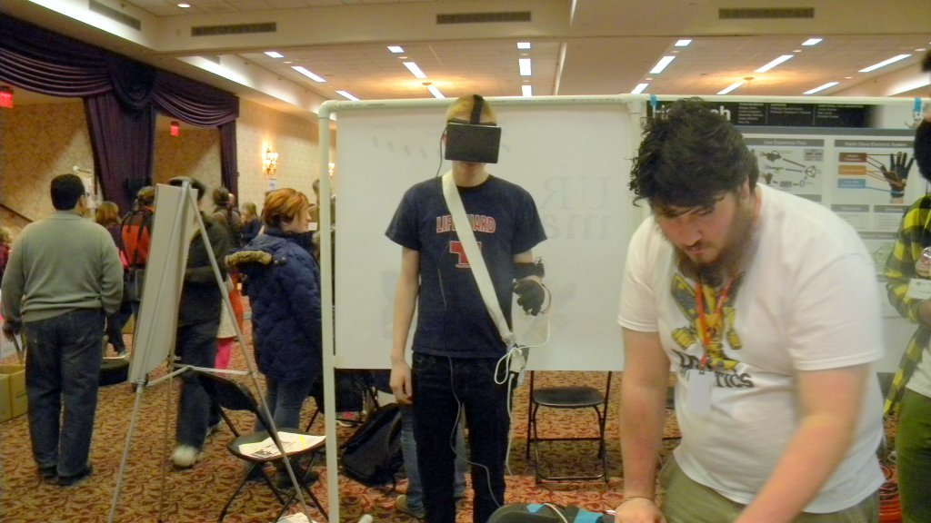

Slide 18
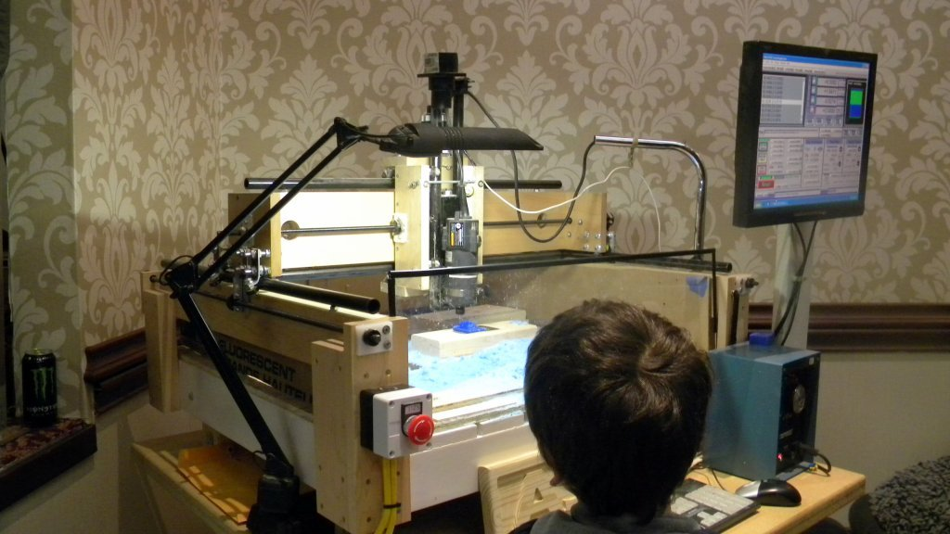

Slide 19
Next Steps
Grow and develop the new Drake Memorial Library Makerspace
Work with students to establish a Maker club on campus
Continue to offer 3D printing and scanning services for the students, faculty and staff at Brockport
Continue collaboration with faculty to incorporate 3D printing and scanning into coursework and projects
Currently working with sculpture class to scan and print ‘coins’ from plaster casts
Move beyond 3D printing and scanning into other maker areas
Sewing and textiles
Arduino
…and beyond!

Slide 20
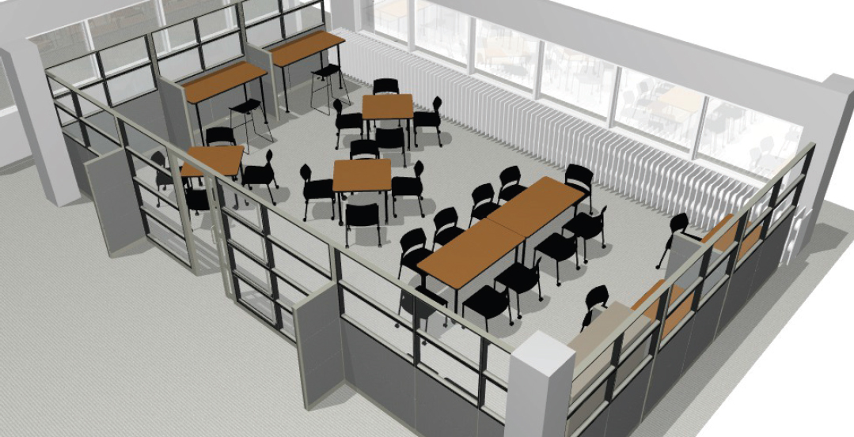
Comments/Questions?
Contact us at:
makerspace@brockport.edu

Slide 21
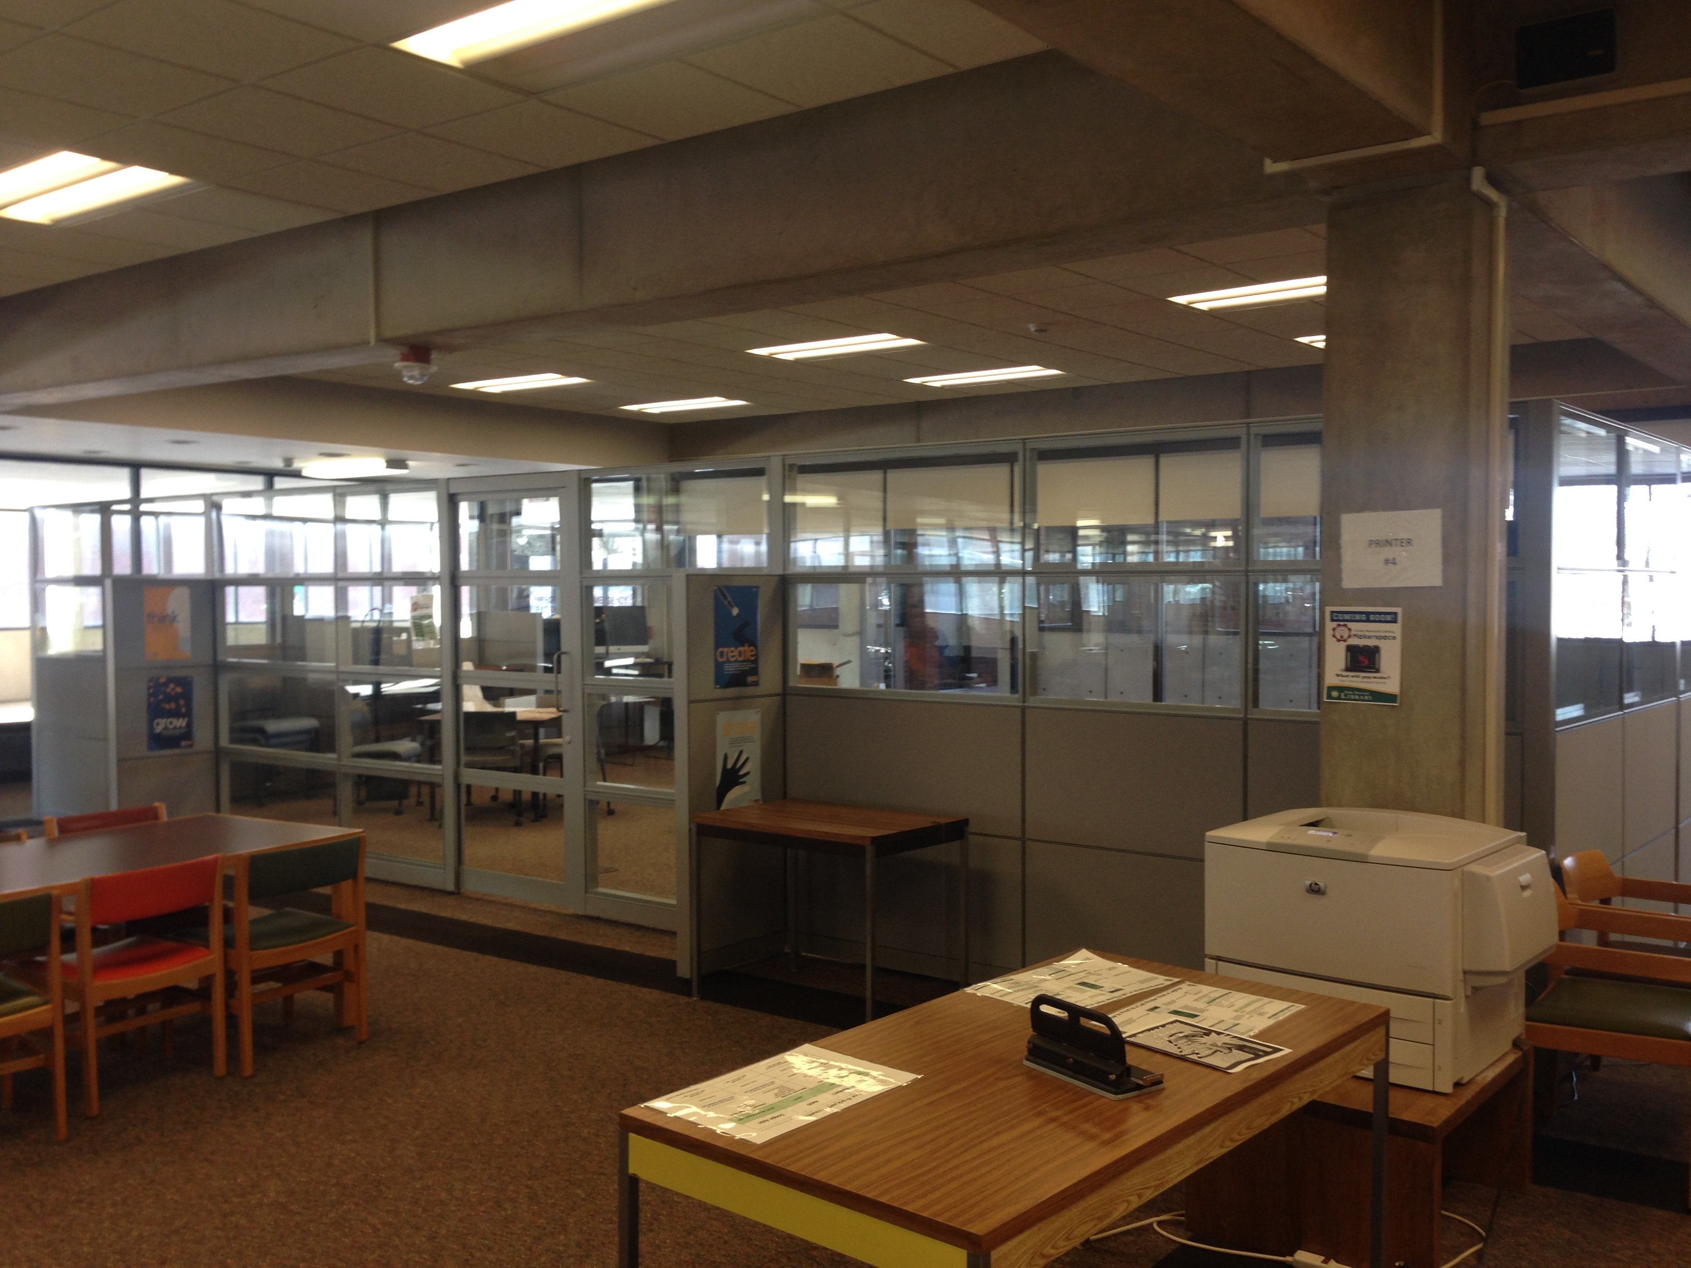
Comments/Questions?
Contact us at:
makerspace@brockport.edu

Slide 22
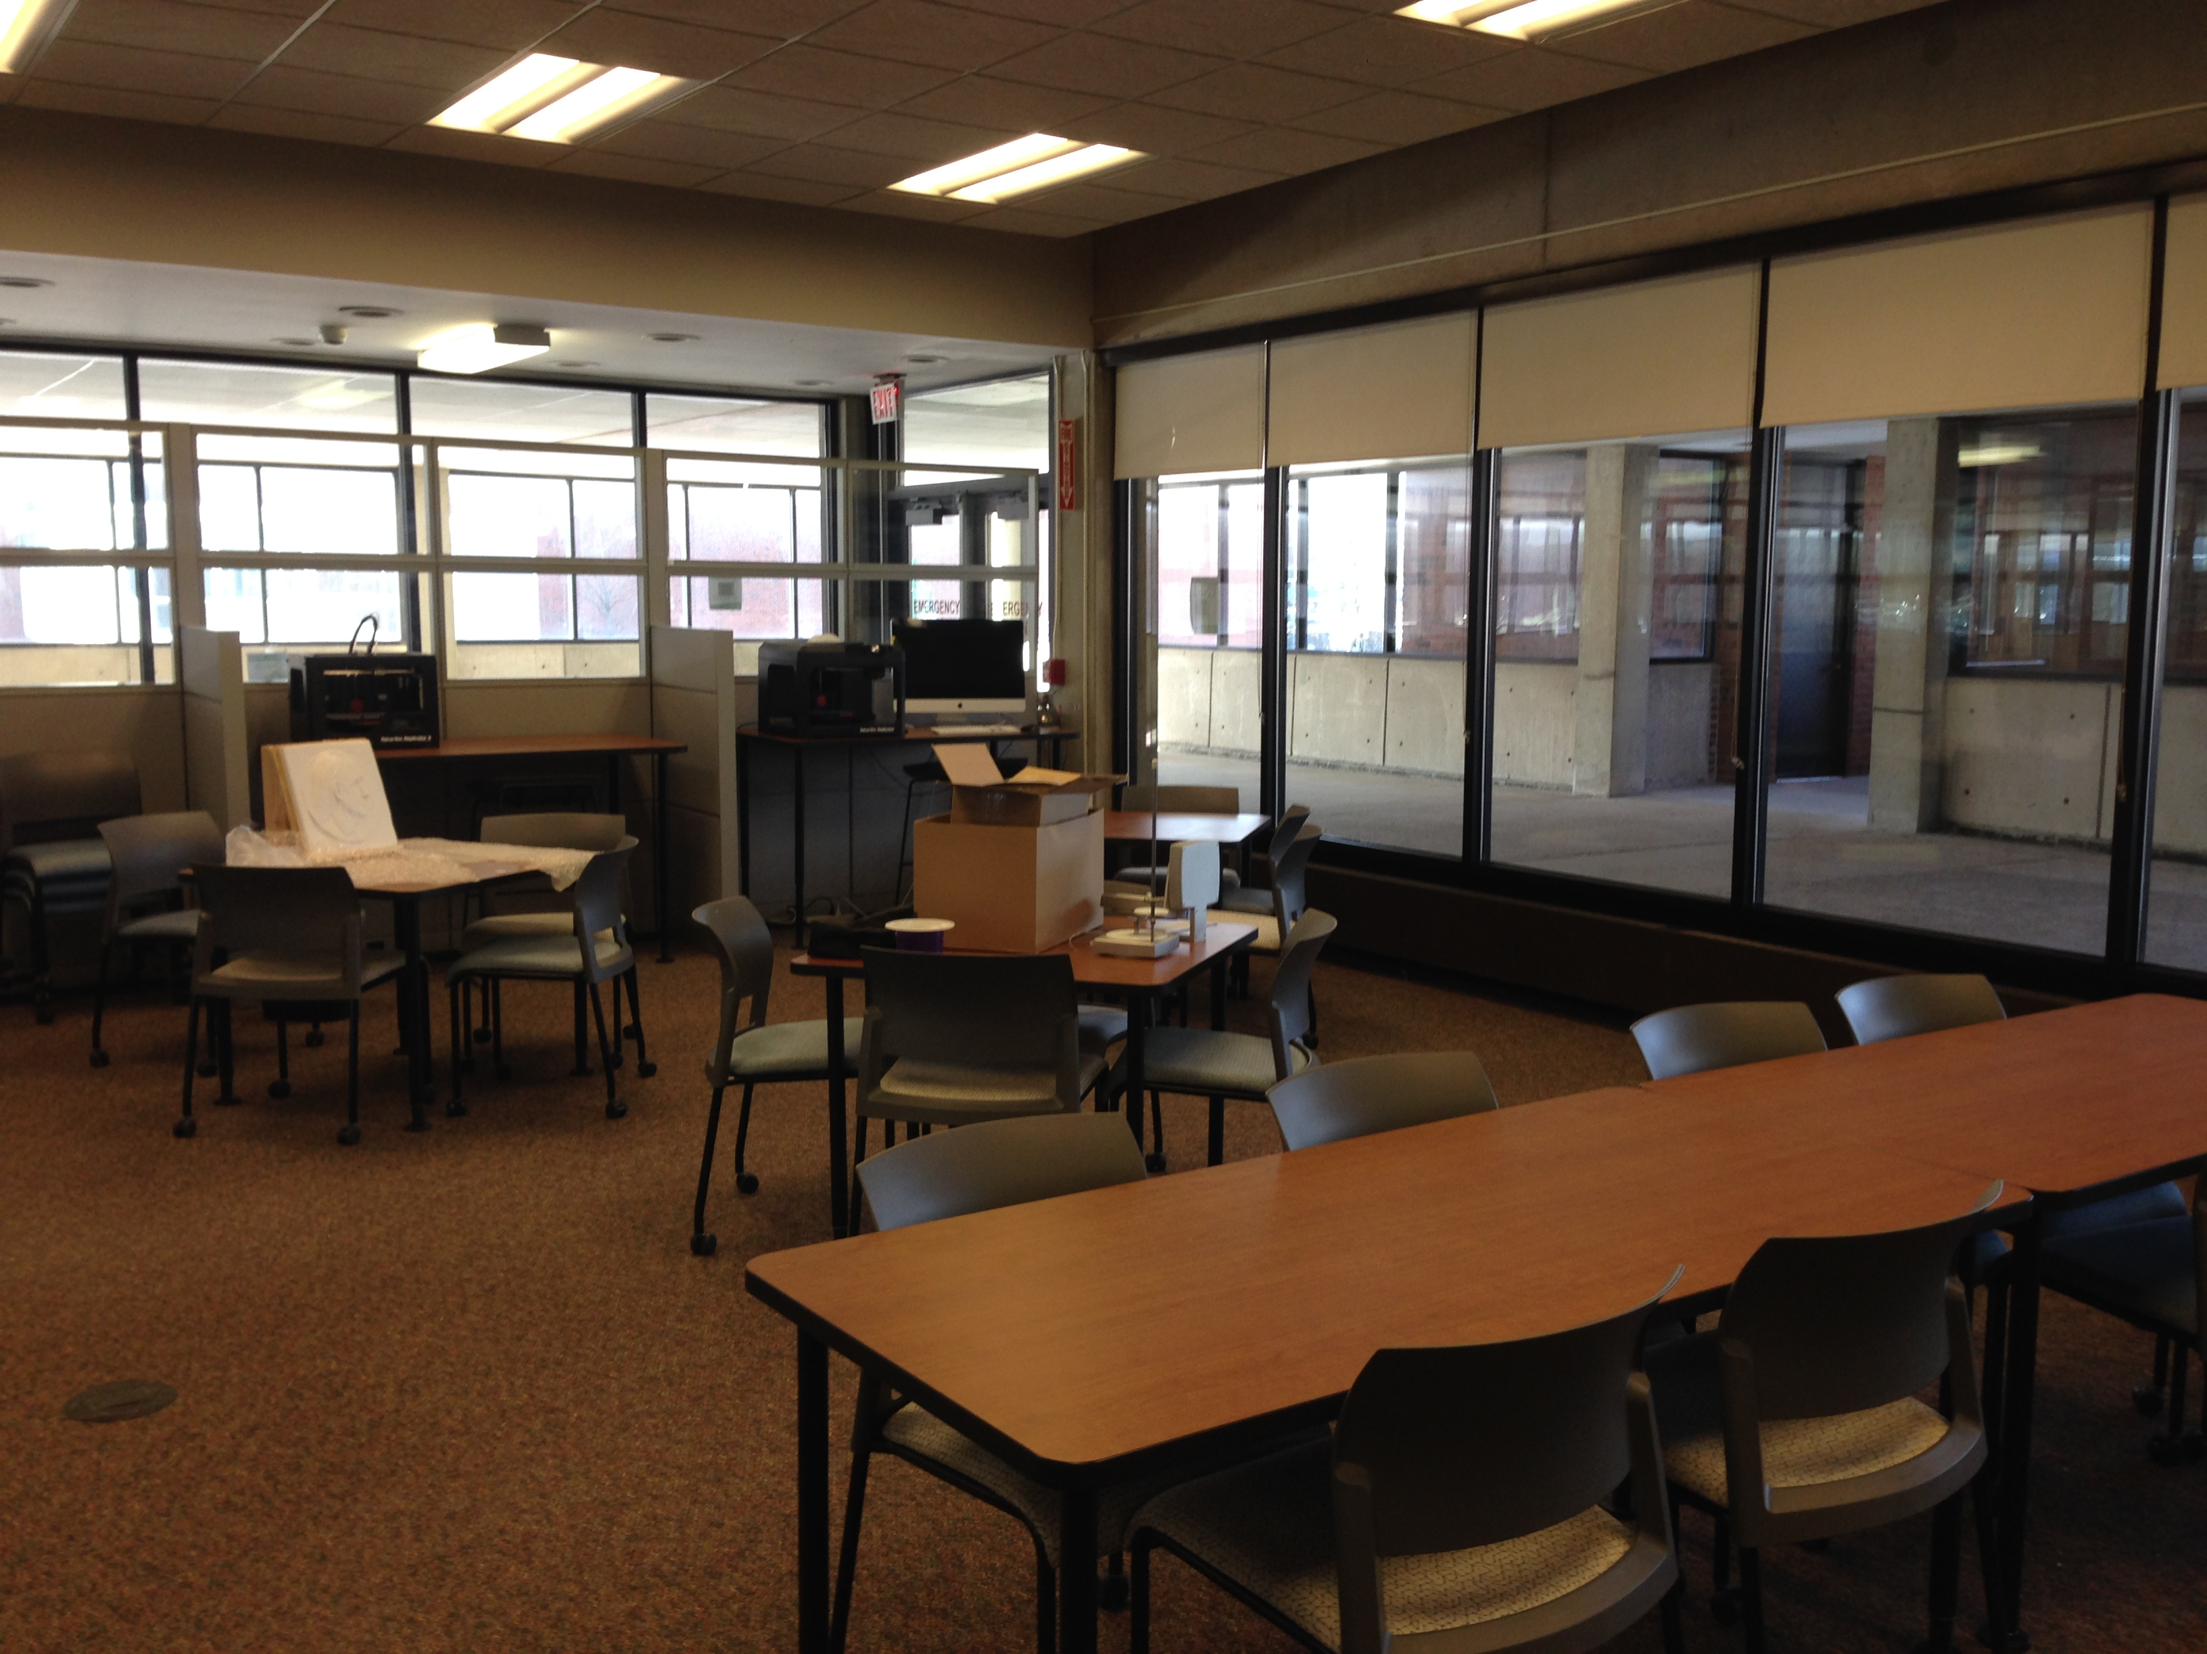
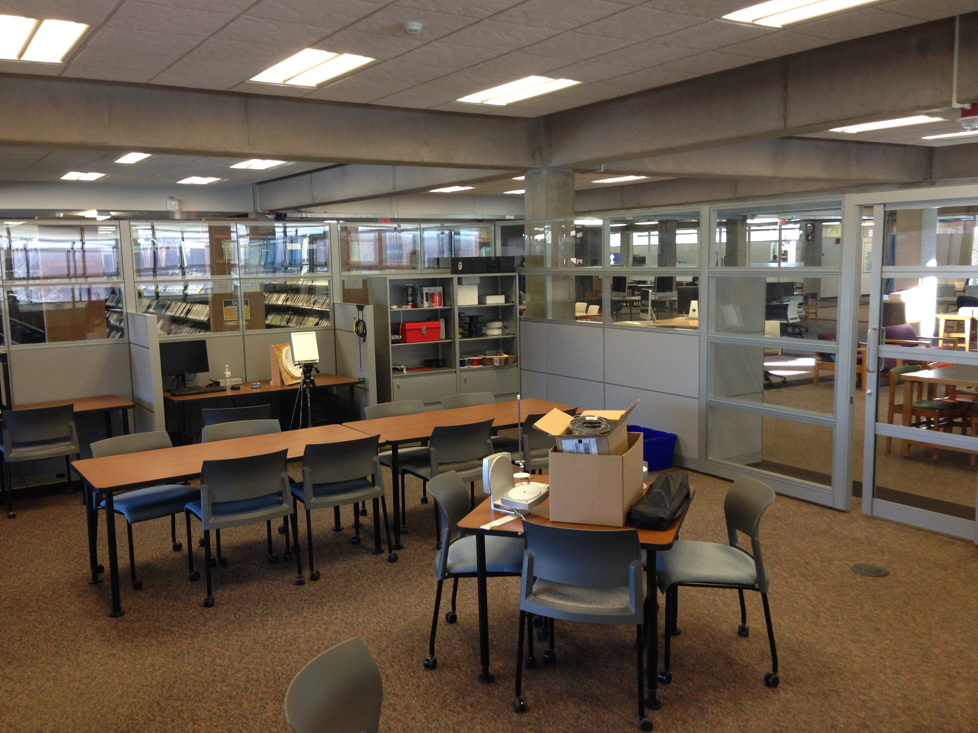
Comments/Questions?
Contact us at:
makerspace@brockport.edu

Slide 23
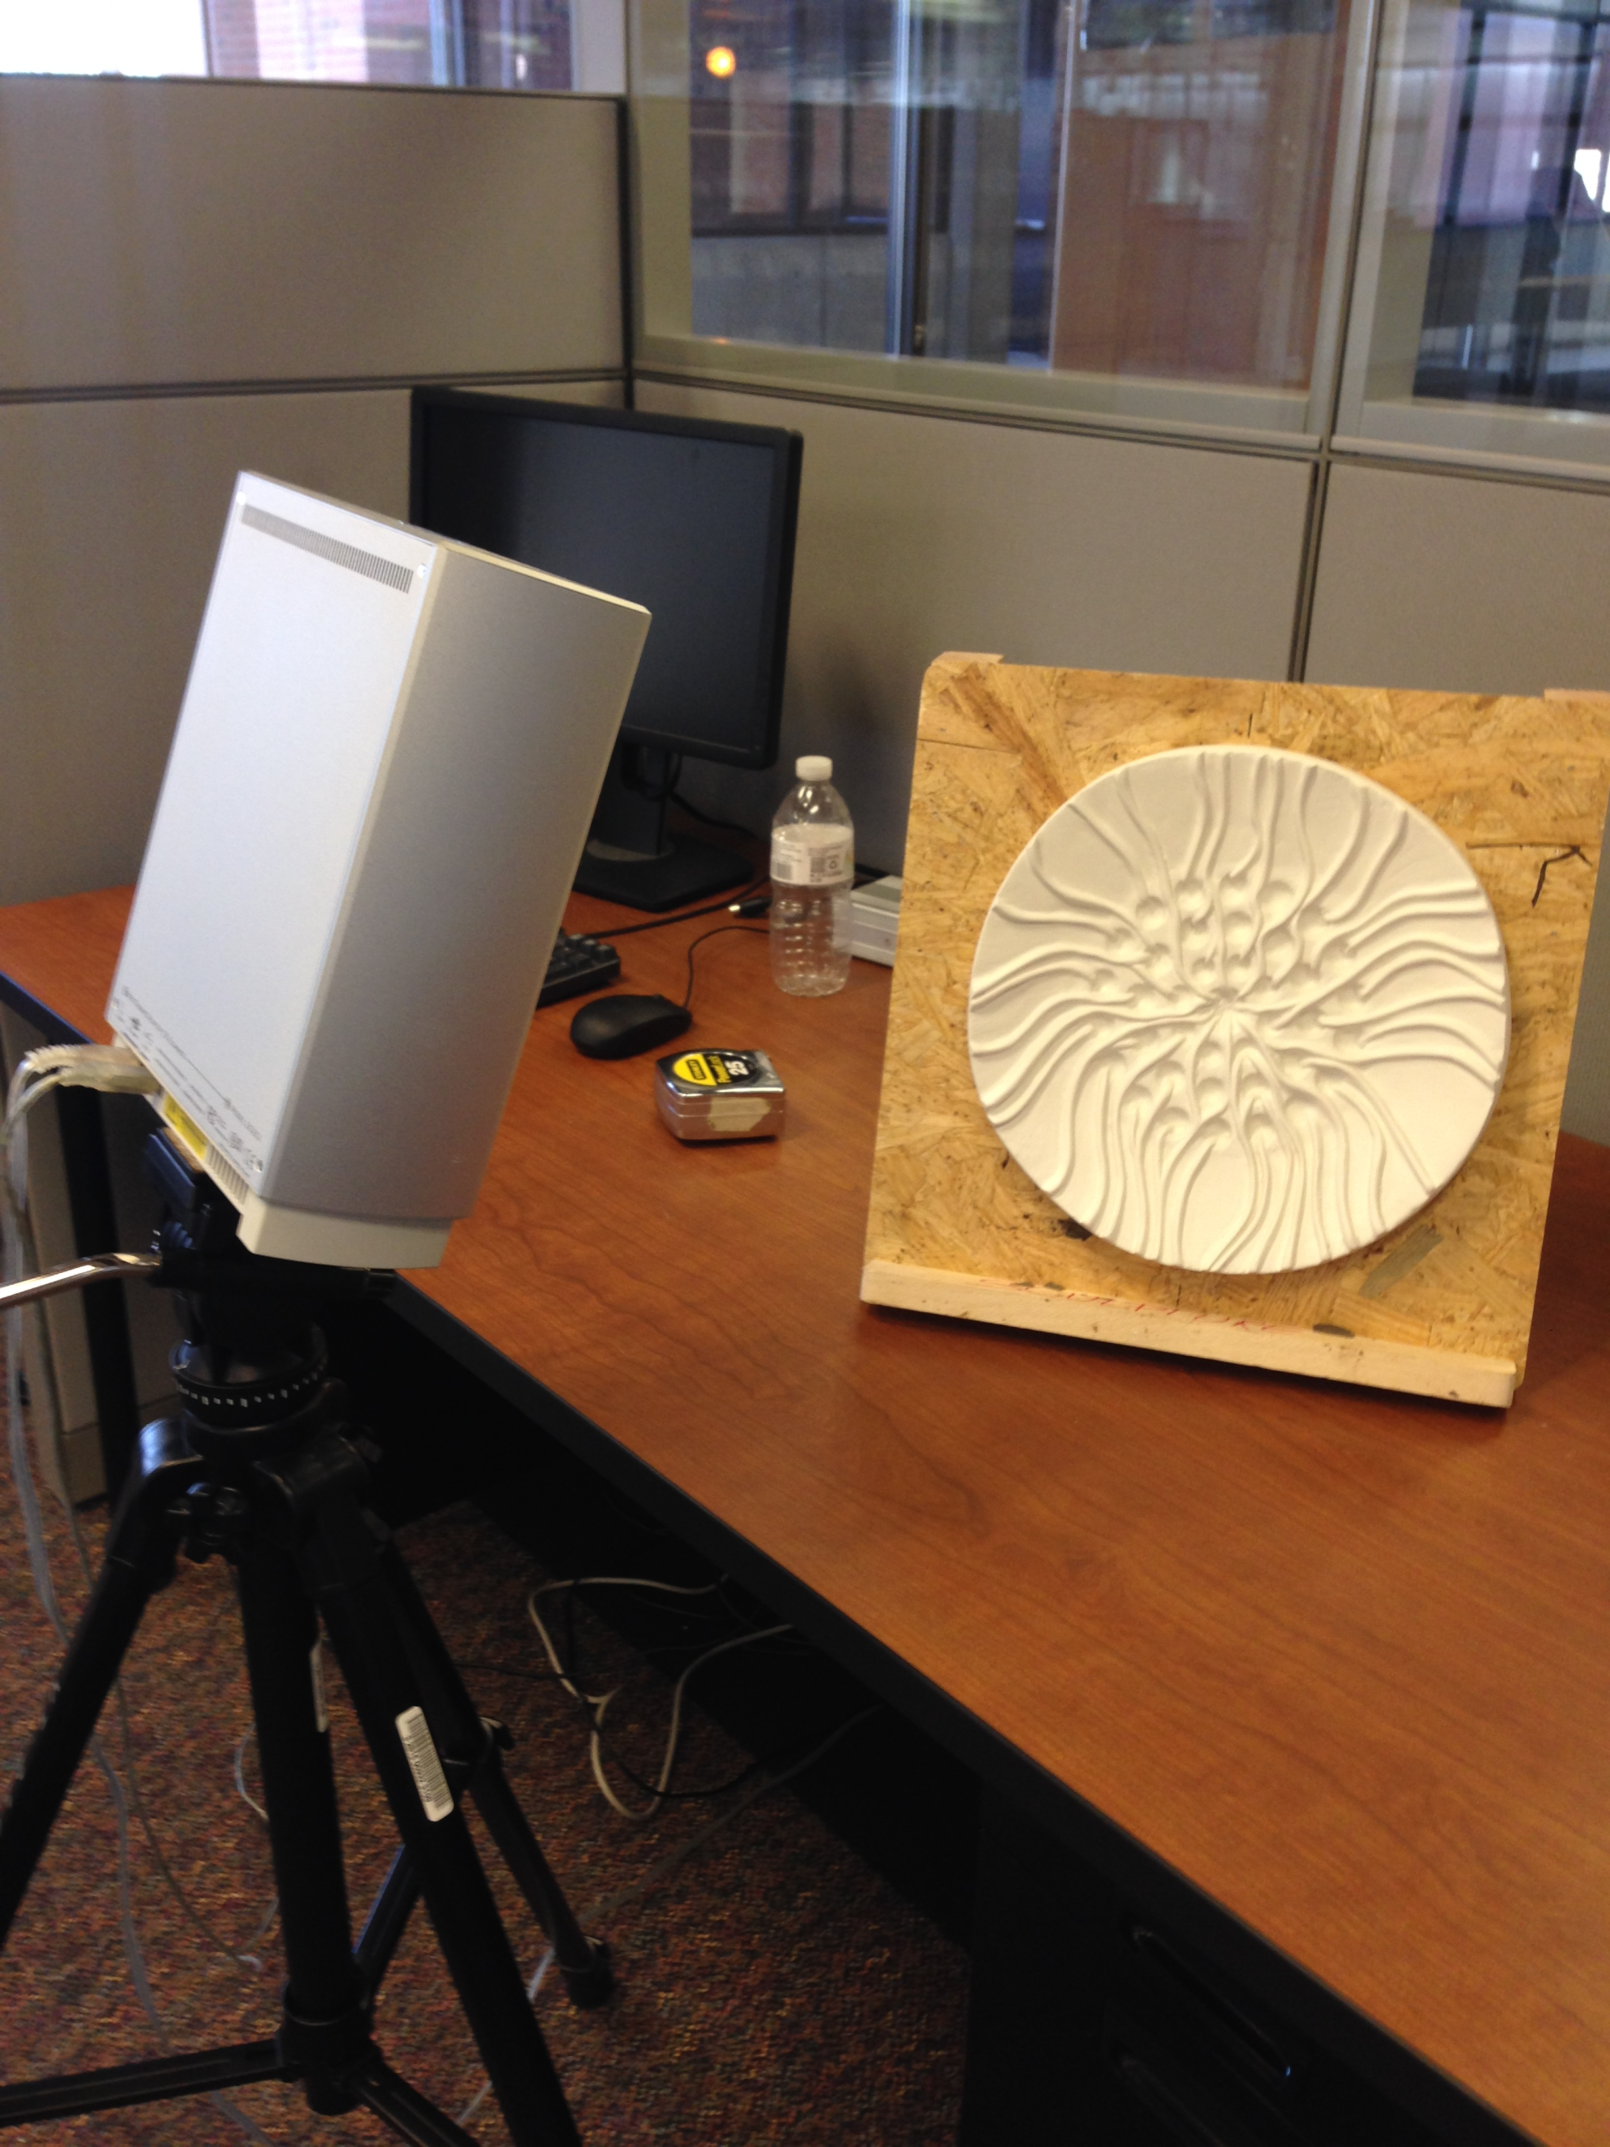
Comments/Questions?
Contact us at:
makerspace@brockport.edu

